Slide 1
Financial instability in football: problems and solutions
Stefan Szymanski
University of Michigan
Primera Conferencia Ernest Lluch de Economía y Fútbol
El impacto de la crisis en el fútbol. Estrategias adaptativas
June 17 2013, Barcelona

Slide 2
It was the best of times…
Football is the dominant global sport
European clubs dominate global football
UEFA Champions League final is now the most watched annual sporting event
Annual income of European football clubs - €17 billion (Deloitte)
Revenues rising at 5.6% pa over last five years

Slide 3
it was the worst of times…
€1.7 billion losses declared by top division clubs in UEFA in 2011
71% of income spent on wages and transfers
63% of clubs in top divisions declared an operating loss
55% reported an overall net loss
38% of clubs reported negative net equity
16% of clubs’ auditors qualified reports on grounds of “going concern”

Slide 4
Understanding the football market
The market for players:
Many buyers and sellers
Skills easily observable
Prices (wages) reflect abilities
The market for fans
Conveyor belt theory-
Existing fans are loyal teams
New fans are more attracted to successful teams
Both the market for players and fans are highly competitive

Slide 5
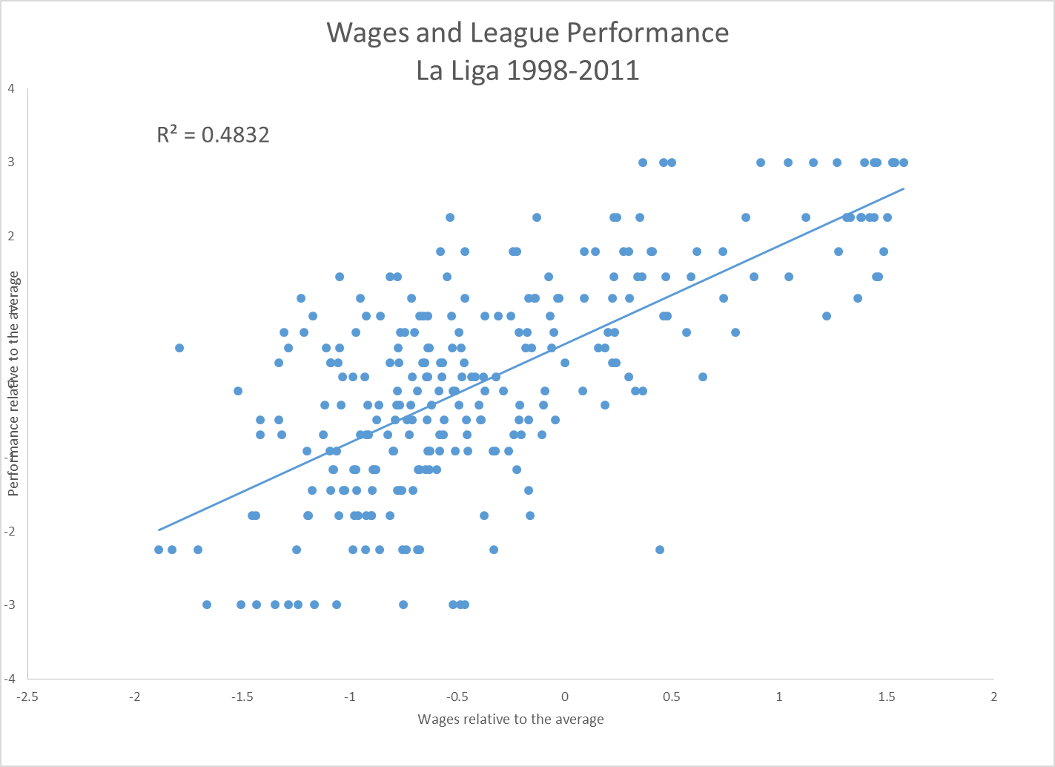

Slide 6
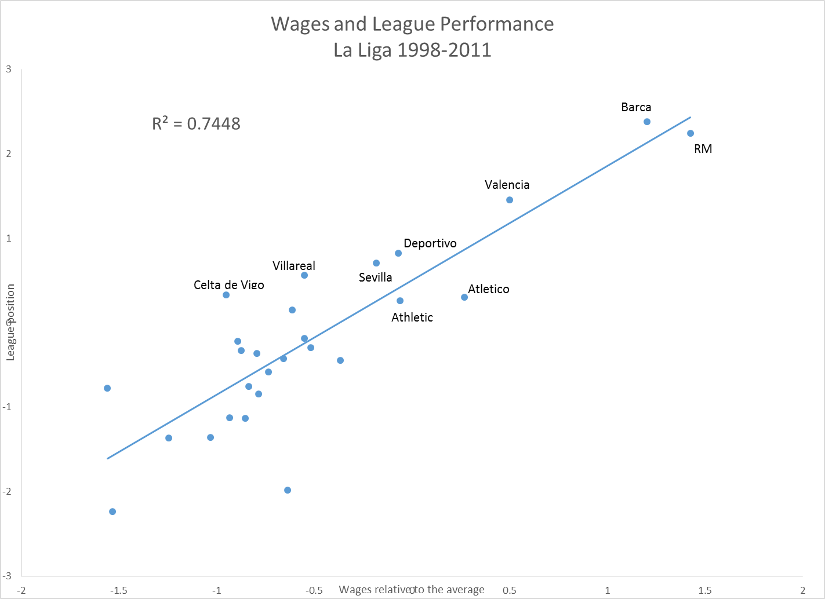

Slide 7
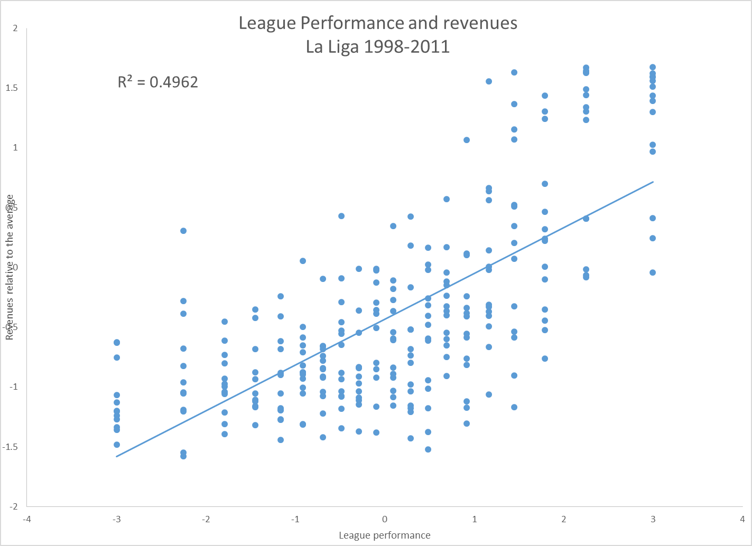

Slide 8
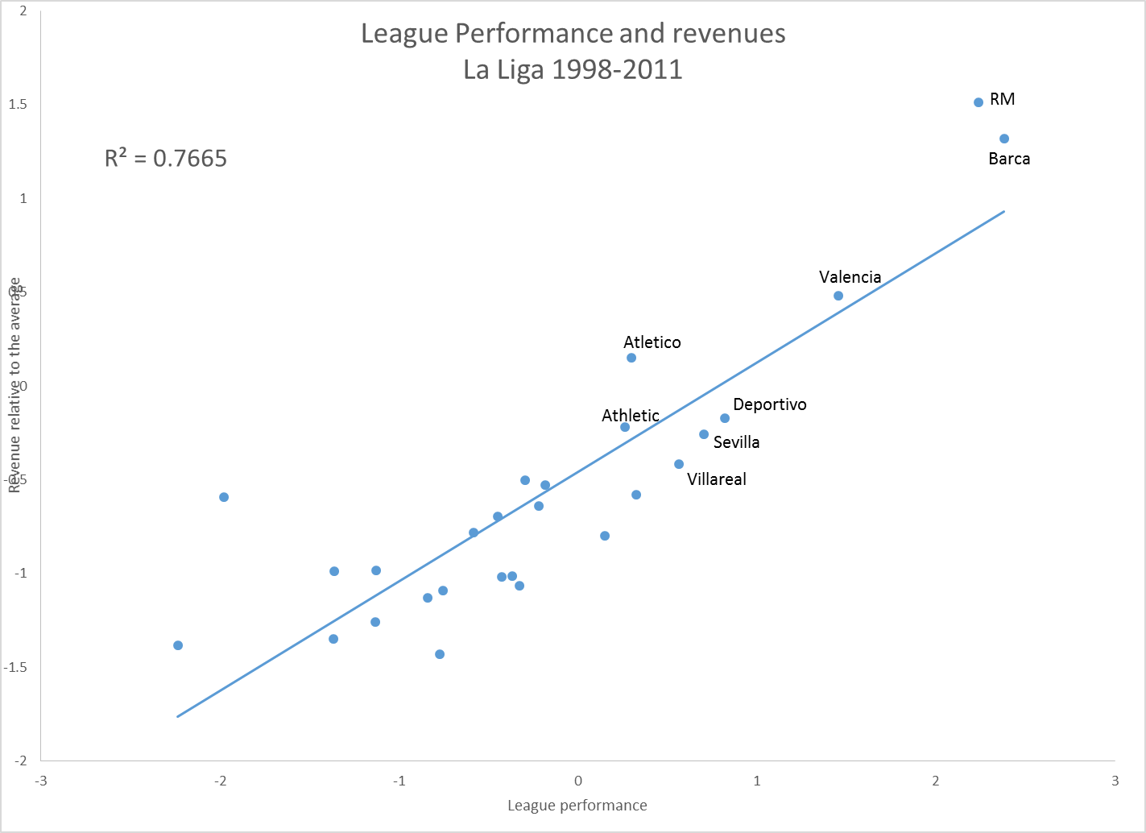

Slide 9
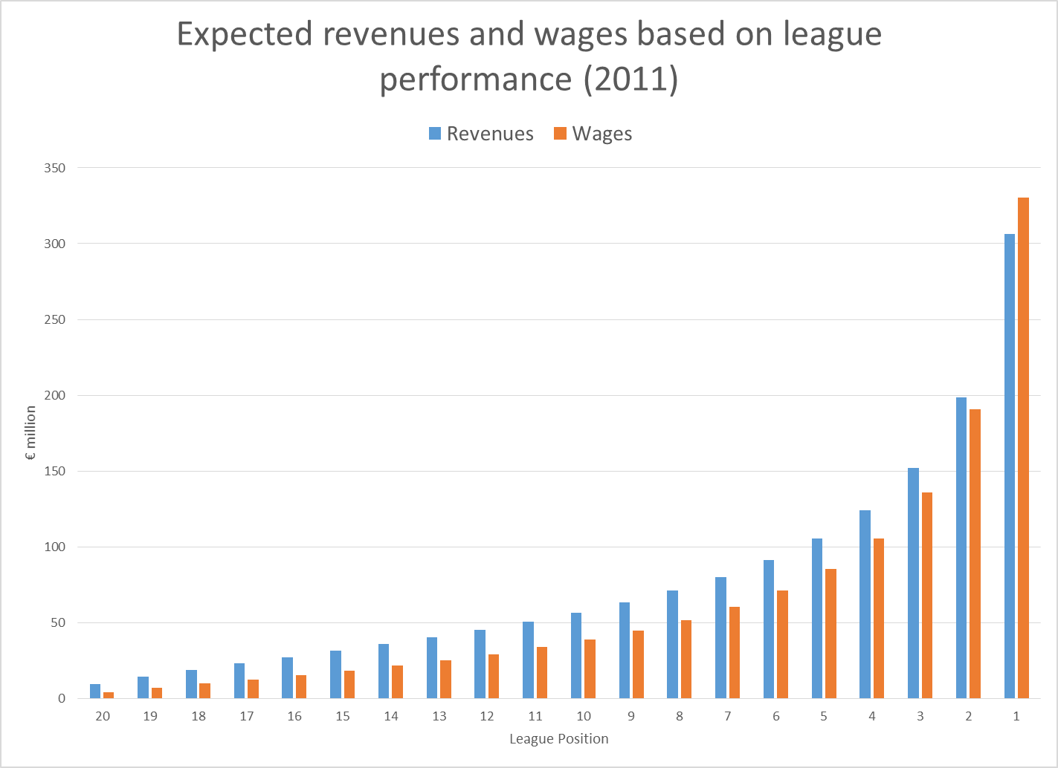

Slide 10
The economic theory of contests
Example: professional marathon runners with a cash prize for winning
The harder you try the more likely you are to win
Effort is not zero, and there is only one winner
The expected return to winning may be positive on average, but in every race only the winner gets a positive return (= prize – effort), everyone else made a loss (= - effort)
Result: most of the time most of the runners make losses, but it is still rational for them to enter the race

Slide 11
Contests and football
Promotion and relegation: a penalty for losing as well as a prize for winning
Short-termism: managers prepared to risk all before they are sacked
Too big to fail: clubs always bailed out
Result: chronic financial losses

Slide 12
Financial instability and survival (I)
Financial crises are endless
Spain - during the 1980s Spanish clubs owed large sums to the tax authorities that they were unable to pay, leading to a government mandated restructuring in 1990 following the Ley del Deporte
England- between 1982 and 1986 there were ten cases where clubs underwent court procedures relating to insolvency- twice in the case of Wolverhampton Wanderers
France -St. Etienne (1982), Bordeaux (1990-91), and Marseille (1993)
Italy – “bankruptcies have been common in the lower leagues since the 1970s…In 1993…six teams were excluded from Serie C1 alone due to financial irregularities”
Germany – Borussia Dortmund bailed out by Bayern Munich in 2002; Schalke 04, Kaiserslautern in mid 2000s

Slide 13
Financial instability and survival (II)
Financial crises are endless…but the clubs always survive
10 clubs founded La Liga in 1929
6 still in La Liga (Barca, Athletic, Atletico, Espanyol, RM, Real Sociedad)
2 in 3rd level (Racing Santander and Real Union)
2 in 4th level (Arenas, CE Europa)
74 clubs in the top divisions in England, France, Italy and Spain in 1950
72 still exist
2 French clubs disbanded (one in 1965, one in 1970)

Slide 14
Why do they survive?
Private investors always want to buy a bankrupt club
Prestige
Publicity
Excitement (gambling)
Football clubs represent social capital
Football fans vote
Local government subsidies usually feasible
Debts are not large

Slide 15
Debts are not large???
Spanish clubs said to owe €1.3 billion in back taxes
Annual football club income around €2 billion
Spain GDP about €1,100 billion
Total Spanish government debt €959 billion
Expected bail out of Spanish banking system €100 billion
€28 per citizen would be enough to write off the football debt…

Slide 16
UEFA Financial Fair Play
Require clubs to pay their debts
Require clubs to break-even
Failure to comply may lead to sanction such as
Exclusion from competition
Fines
Reprimand

Slide 17
Break-even rule
“Football income” must cover “football expenditure”
Football income - matchday, merchandising, sponsorship, TV
Football expenditure – wages and transfers
Contributions from “sugar daddies” do not count toward break-even

Slide 18
Why is restraining sugar daddies a mistake?
Not really the problem- mostly it is small clubs without sugar daddies that are insolvent
Sugar daddies have brought money into European football- Manchester City and PSG spending helps to prop up clubs in other countries
A small number of big clubs dominate Europe – a danger of “ossification” - only sugar daddies can challenge the big clubs
Rules will reduce wages for the big clubs without any clear benefit for consumers or players- contravenes European competition law (salary caps in the US are designed to benefit fans as well)
Too many opportunities for corruption and cheating

Slide 19
The real problem
Increasing inequality in income – big clubs are global competitors, small clubs are merely local
Unequal competition strains the weaker clubs
Too few opportunities to see big clubs play each other (Barca has played Bayern Munich only 4 times in the last decade)

Slide 20
Real solutions
Abolish promotion and relegation –adopt an American style closed league system
Redistribute income to ensure more equality between the big and the small teams

